Slide 1
Using NetBeans IDE
Purpose: Start to work with the IDE we will use for developing Java projects

Slide 2
Resources
Online NetBeans Help & Java Docs

Slide 3
Intro
There are many different Third Party tools that can be used to develop a Java program.
In fact, we could simply use notepad to create .java files

Slide 4
Intro
We could use JSDK and command line prompt to compile and run our programs
However, there are many other software packages that make this effort much easier
We will use NetBeans
Other tools are BlueJ, Jcreator, Eclipse

Slide 5
First Things First
If you do not already have it, Create a LINK on your Desktop to the JAVA DOC (v 1.5)

Slide 6
First Things First
The Java Doc is on EACH computer in the following folder:
DOCUMENTS AND SETTINGS/ALL USERS/DOCUMENTS/
This document will be used to work with Java Classes

Slide 7
The Basics
Before you write a project you need to CREATE A FOLDER IN YOUR AREA ON THE FILE SERVER
To run your programs successfully, YOU must be logged on to the server with YOUR student account

Slide 8
The Basics
Save through the My Documents folder on the workstations Desktop
MAKE SURE YOU ARE WORKING THROUGH DOCUMENTS and SETTINGS / MY DOCUMENTS
Add a folder called: HelloWorld

Slide 9
The Basics
The work you do while logged on is SYNCHRONIZED & saved on the FileServer when you LOG OUT, so Make sure you LOG OUT at the end of each class or your work
WILL BE LOST !!!!!

Slide 10
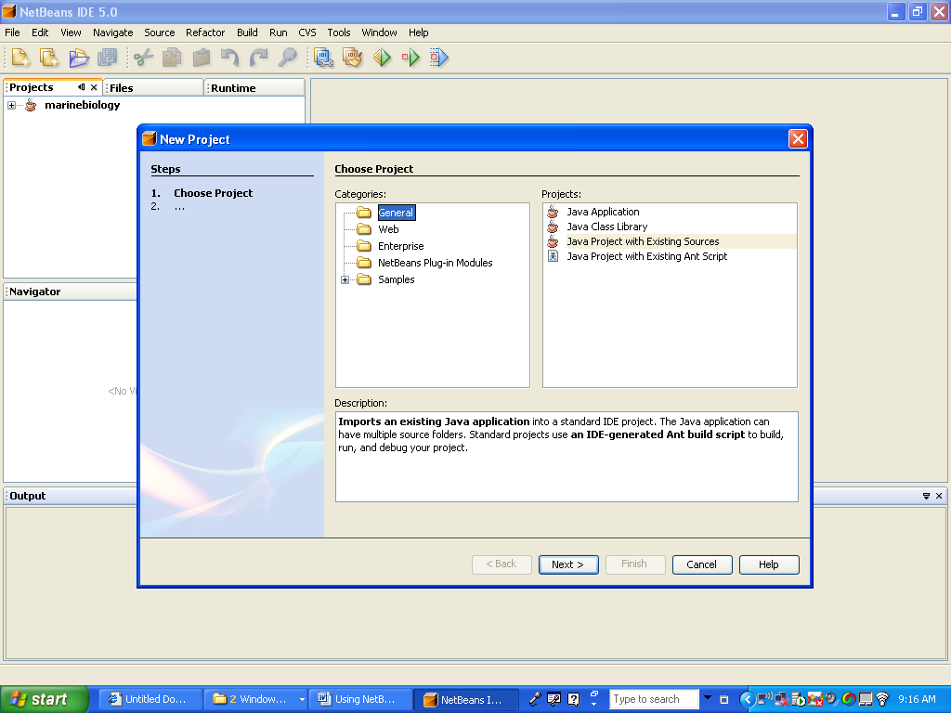
Run Net Beans

Slide 11
Run Net Beans
Create a new Java Application Project
FILE NEW PROJECT
You have TWO choices:

Slide 12
Run Net Beans
Select General … Java Application to create a new project that does not use any pre existing Classes or source files
Select General … Java Project with Existing Sources if you plan on using pre existing JAR, class or source files.

Slide 13
Run Net Beans
The “MBS INSTALLATION DOCUMENT.DOC” that details the procedure for using this option.
For now, select the first choice.

Slide 14
Run Net Beans
Name the project helloworld and select the options as follows:

Slide 15
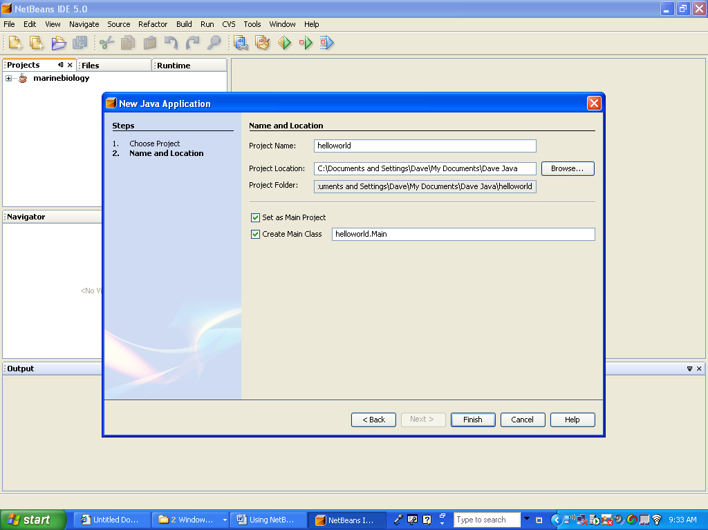
Run Net Beans

Slide 16
Run Net Beans
Select FINISH
You will get the following main project. Code the following in the SPVM and then run it by clicking On the run Icon:
System.out.println("hello world");
The result is on the bottom of the following screen shot:

Slide 17
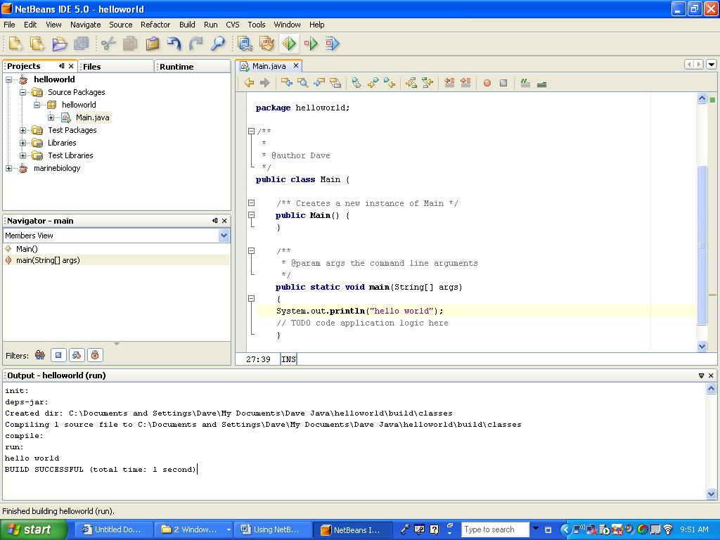
Run Net Beans

Slide 18
Look at Resulting Files
In the Source Packages, you have the helloworld folder. In this folder you have the main file MAIN.JAVA
This is the file where the SPVM will be executed.

Slide 19
Look at Resulting Files
In the Libraries package, you have the JDK 1.5 PLUS any other packages you require for this program.

Slide 20
Look at Resulting Files
When you are done working, close your project and close NetBeans. Then BACKUP your project by COPYING the entire project folder to your smart drive.

Slide 21
Look at Resulting Files
If you work on the project at home, save the whole folder back onto the smart drive and then COPY the entire folder onto your student account OVERLAYING the previous project.

Slide 22
Look at Resulting Files
Debugger:
Have some fun by changing your source code and then RECOMPILE
See if you can identify the errors
Use the debugger to set a breakpoint

